Slide 1
Green Up Your Home

Slide 2
Notes:
Our choices and the choices of others make massive impact on the world we live in.

Slide 3
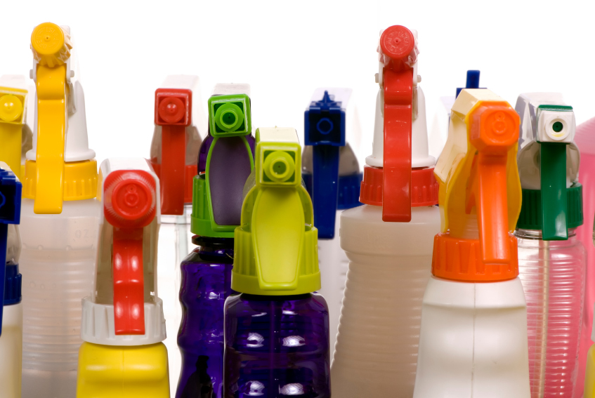
How Clean Are the “Cleaners”?
Notes:
80,000 chemicals registered with the EPA in the last 30 years and only 2% have been tested for their safety!
90% of all poison exposures occur at home.
Indoor air pollution causes 1 death every 20 seconds according to the World Health Organization.(from World Watch Institute, Cleaning Products)
Since the ingredients of many household products are considered “trade secrets, only the manufacturers know exactly what is in them.

Slide 4
Notes:
Start with your own home.
Take inventory. We have the most control over combating toxins in our homes.
We teach all the time in our classes that we want to help people reduce the toxic load in their bodies. So let’s be intentional and not add to this burden with every load of laundry or every toilet cleaning!
Honestly, just starting with the ways in which we clean our homes is a simple and great place to start.

Slide 5
Step 1 - Become Aware

Slide 6
Green Living Isn’t a Luxury…
It’s a Responsibility
Notes:
Making “Green” choices have an immediate impact on us
WIN-WIN Relationship!
Serves the planet AND serves us & our families
Both Selfish & Self-less

Slide 7
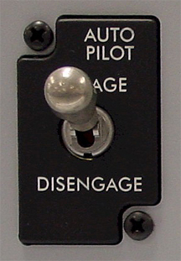
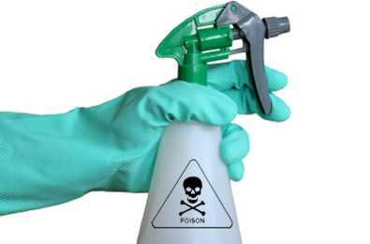
Step 2 - Disengage the“Autopilot”
Notes:
Rethink the things we have ALWAYS done and see where you can make positive changes.
CLEAN doesn’t have to mean CHEMICAL!
Doesn’t need to be a massive undertaking
Will SAVE YOU MONEY
Our bodies have an amazing ability to heal & recover. So start NOW!

Slide 8
Step 3 - Less Is More
Notes:
Take it slow. 1 or 2 changes at a time.
Some will want to go home and start over from scratch and get rid of everything. But if that overwhelms you, just pick one new thing to try this week. And then move onward from there.

Slide 9
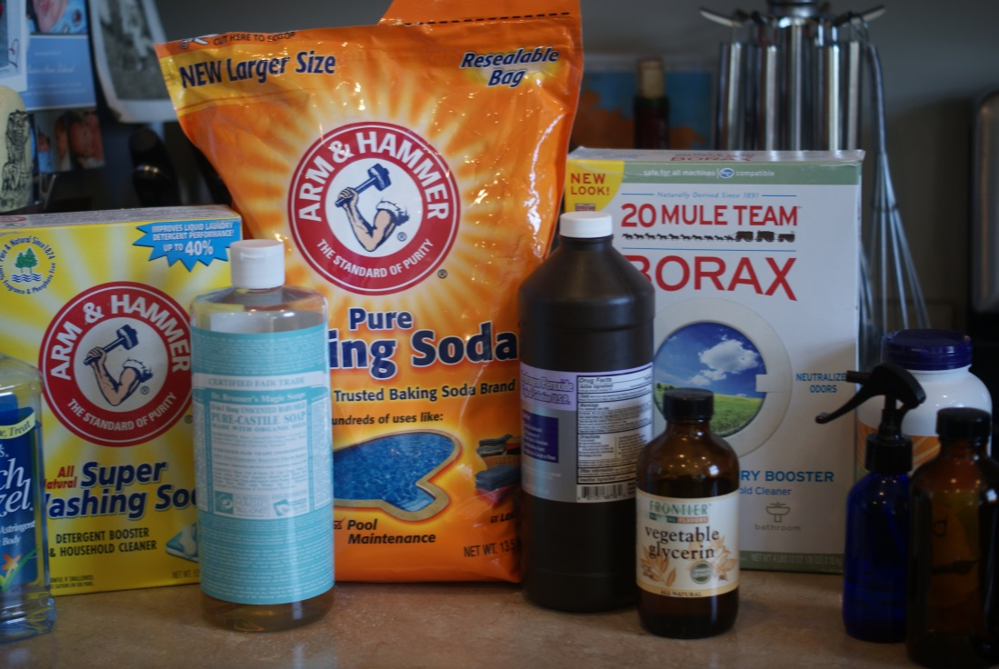
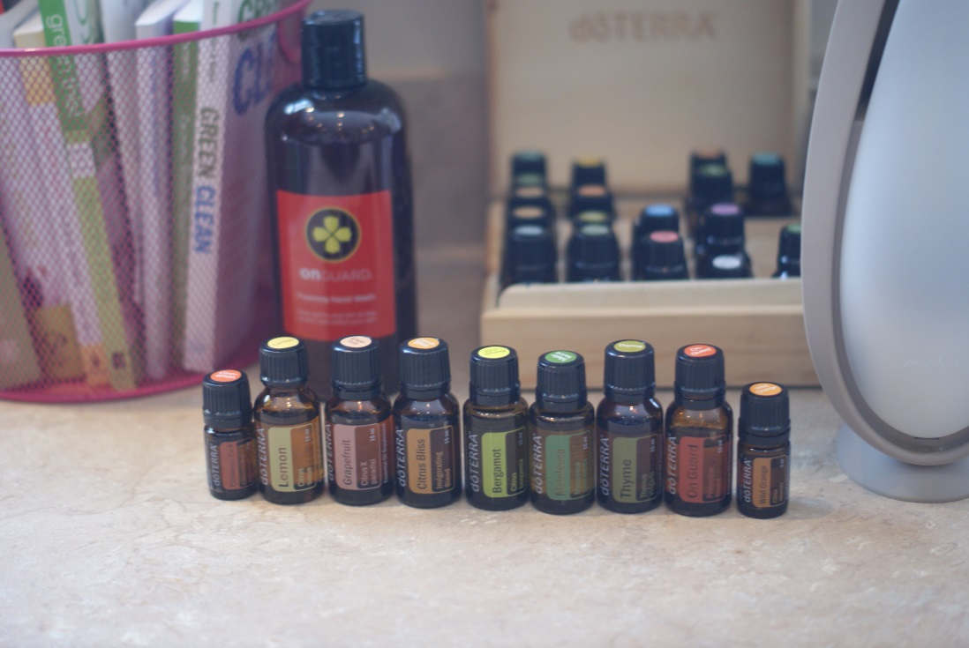
Makeover Your Cleaning Cabinet

Slide 10
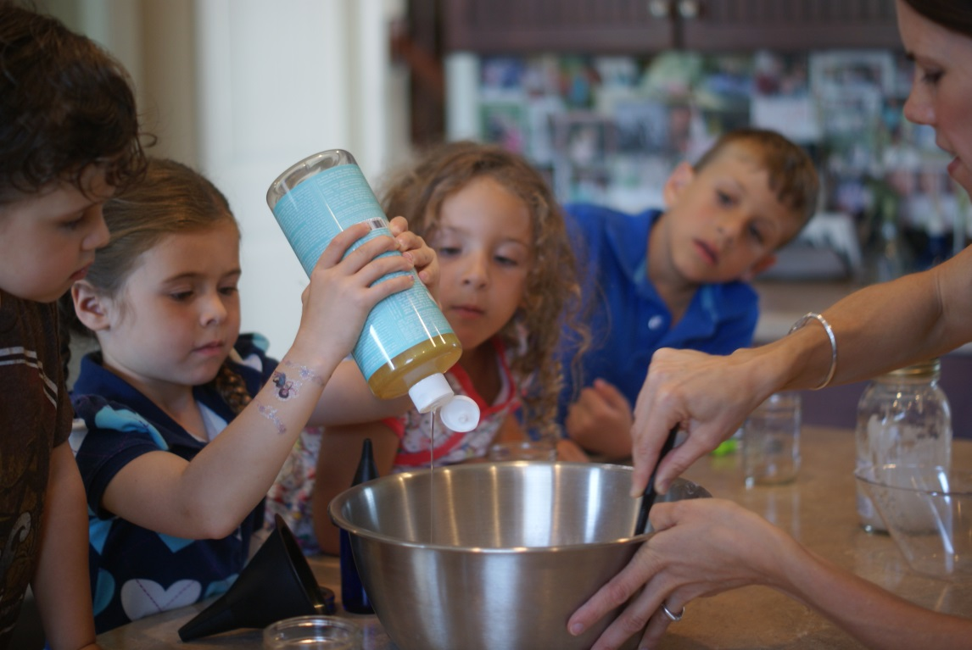
Get the FAMILY Involved!

Slide 11
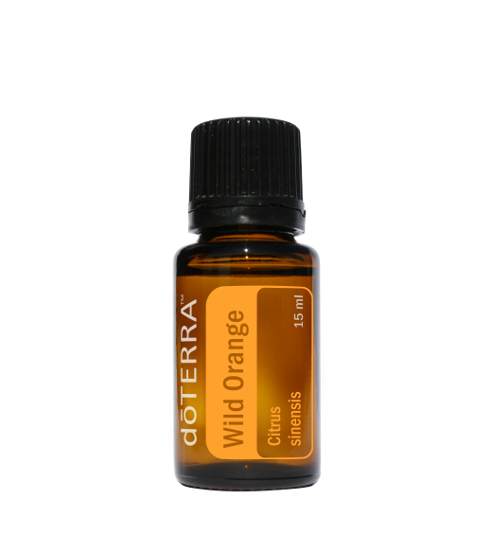
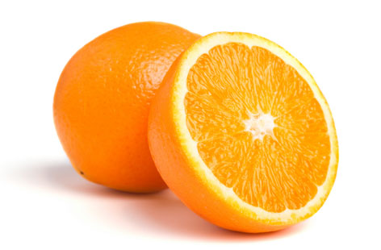
Wild Orange
Sunshine in a Bottle
Simply drip a drop on any surface for an uplifting cleaning experience!
Diffuse in a room to neutralize odors and elevate the mood.
Add to DIY soaps & detergents for great aroma.
Amazing goo-gone.
Add to smoothies, frosting and other foods for a sweet burst of flavor.

Slide 12
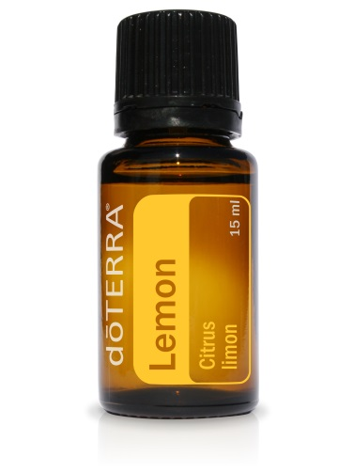
Lemon
Clean & Freshen
Great all natural fruit wash. Add several drops to a spray bottle with water. Spray and wipe fruit clean!
Diffuse in a room to neutralize odors and elevate mood.
Degreaser & Furniture Polish for wood, stainless steel appliances, and more.
Dissolves sticky substances.
Removes glue, paint, marker & more!

Slide 13
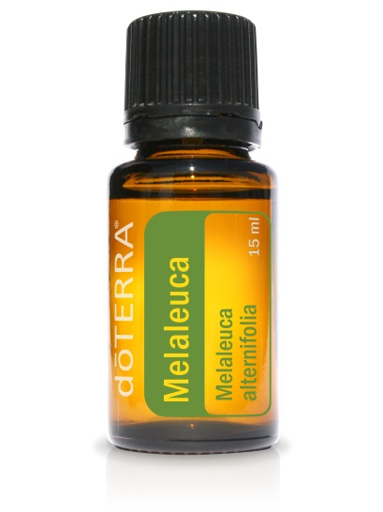
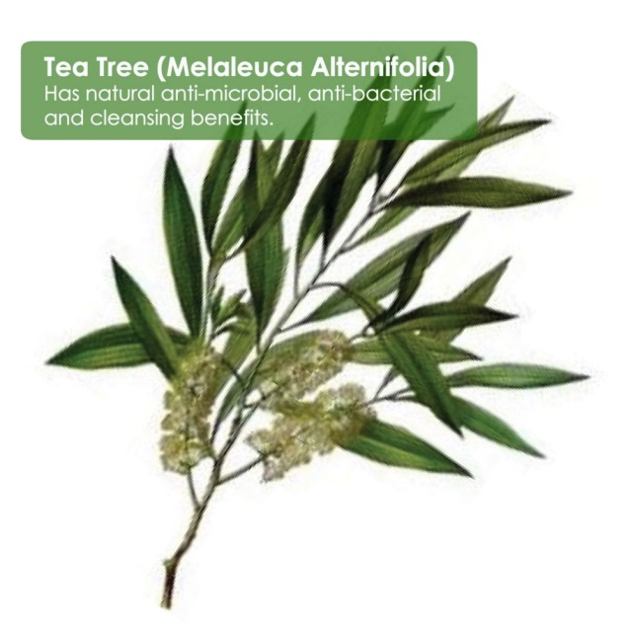
Melaleuca
Tea Tree Oil
Mix 10-15 drops with vinegar and baking soda for toilet scrub.
Effective and safe surface cleaner.
Use with shampoo and conditioner for healthy scalp and hair.
Apply to blemishes and rashes as a part of daily cleansing program.

Slide 14
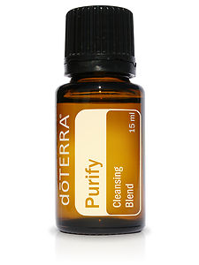
Purify
Cleansing Blend
Eliminates odors, pathogens & mold.
Room deodorizer.
Countertop sanitizer.
Add several drops to laundry or dish washer to freshen and purify.
Add 15 drops to 24 oz. spray bottle filled water and ¼ cup vinegar for a shower spray.

Slide 15
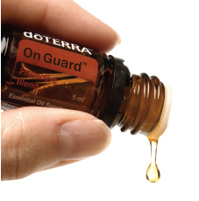
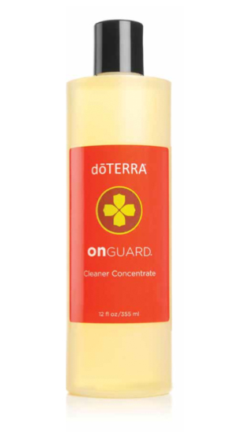
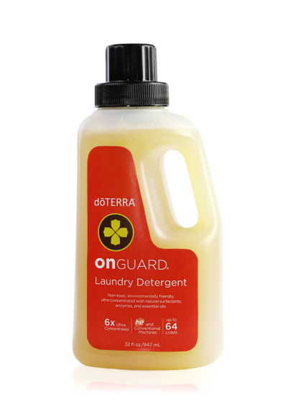
OnGuard
Diffuse to eliminate airborne pathogens.
Dilute in spray bottle to clean doorknobs, telephones, and other surfaces.
Mix with water or coconut oil for all natural hand sanitizer.
Protective Blend

Certified Pure Therapeutic Grade
© 2012 dōTERRA Holdings, LLC, Unauthorized duplication prohibited

Slide 16
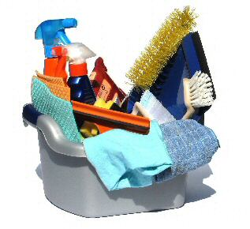
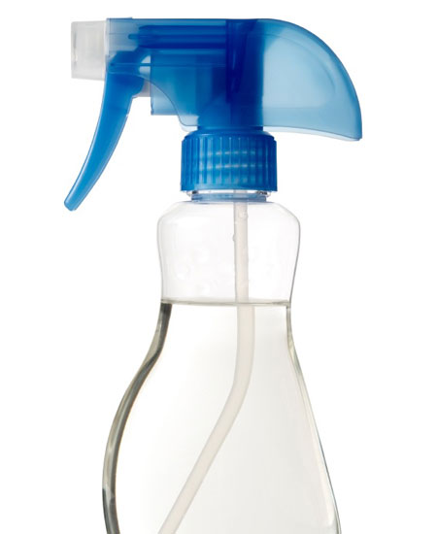
Cleaning Recipes 101
ALL PURPOSE CLEANER
1 tsp. Borax 2 TBS. white vinegar 1/2 tsp. castile soap 2 C very hot distilled Water 5 to 6 drops essential oil
DISH SOAP 2 C of Castile Soap
½ C Warm Water
3 drops Essential Oil
WOODEN FLOOR CLEANER 1 part white vinegar
1 part water
Add 5 drops Lemon oil, 2 drops Melaleuca, and 5 drops Lavender oil.
MIRROR or WINDOW CLEANER 1 1/2 C Vinegar 1/2 C Purified or Distilled Water 8 drops Any Citrus Essential Oil
DISHWASHER DETERGENT PODS 1 C Baking Soda
¼ C Citric Acid
1 Tbs. OnGuard Cleaner
½ Tbs. Castile Soap 10 drops Purify
Mix thoroughly and dry in silicone molds
AIR FRESHENER
10 drops lemon
6 drops bergamot
5 drops lime
5 drops grapefruit
Dilute with distilled water
and spray as needed

Slide 17
OnGuard Cleaner Concentrate
Primary Benefits and Uses
Cleans and protects by eliminating seasonal and surface-borne threats
Free of petroleum, ammonia, chlorine bleach, borates, phosphates, nitrates, and volatile organic cleaning compounds
SO Many Uses!
For Multi-Purpose Cleaning
For Laundry
For Bathrooms
For Dishes
For Tough Jobs

Certified Pure Therapeutic Grade
© 2012 dōTERRA Holdings, LLC, Unauthorized duplication prohibited

Slide 18
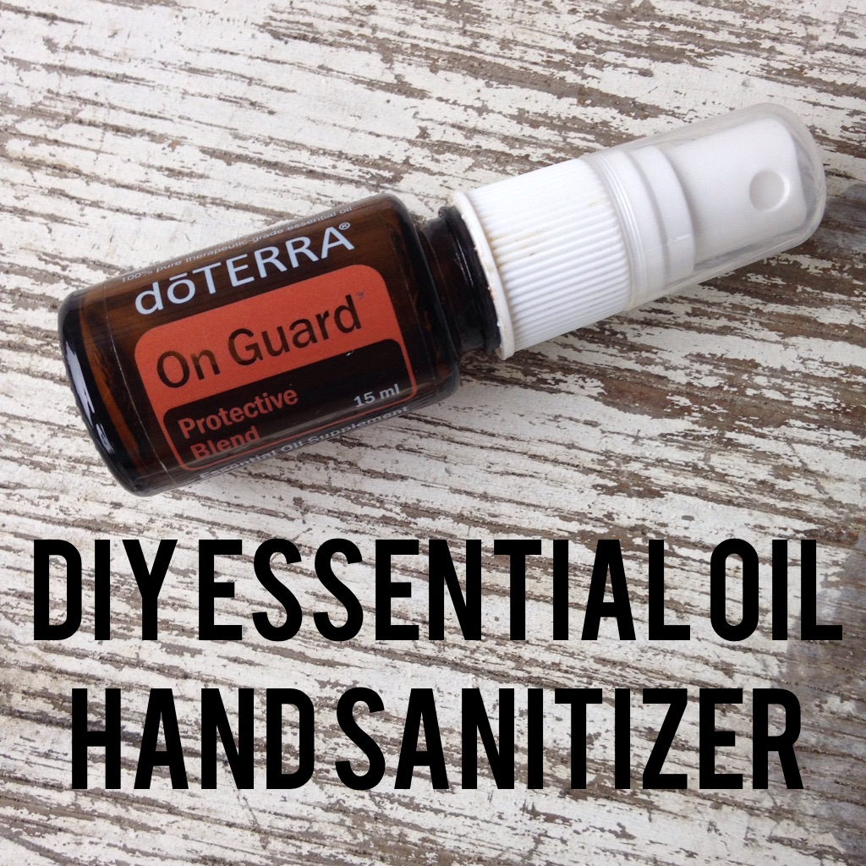

Slide 19
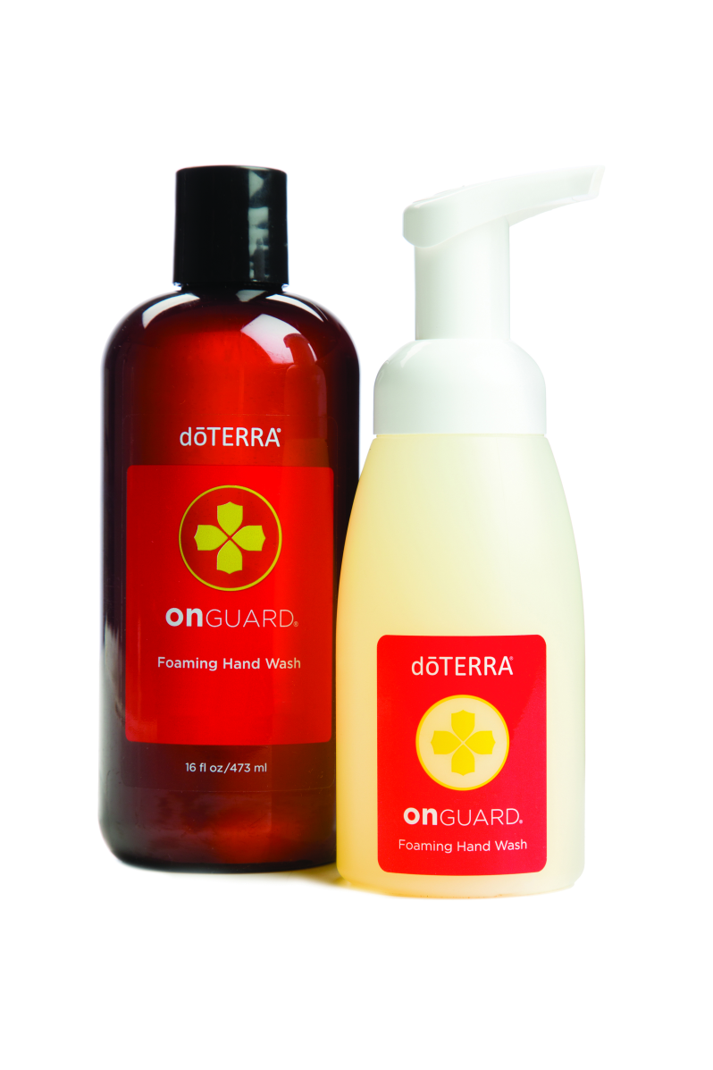
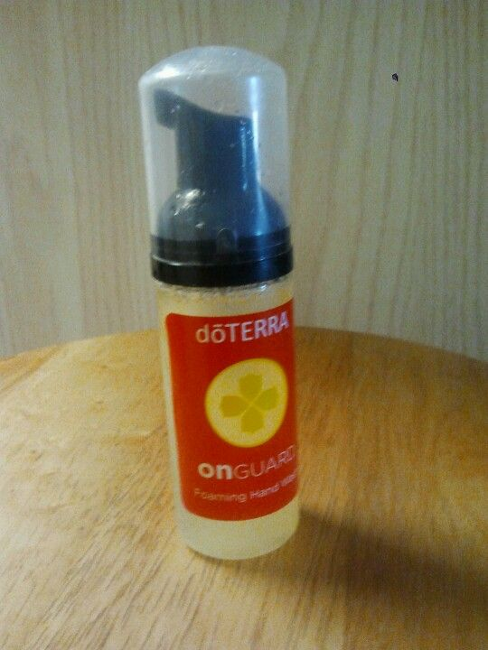
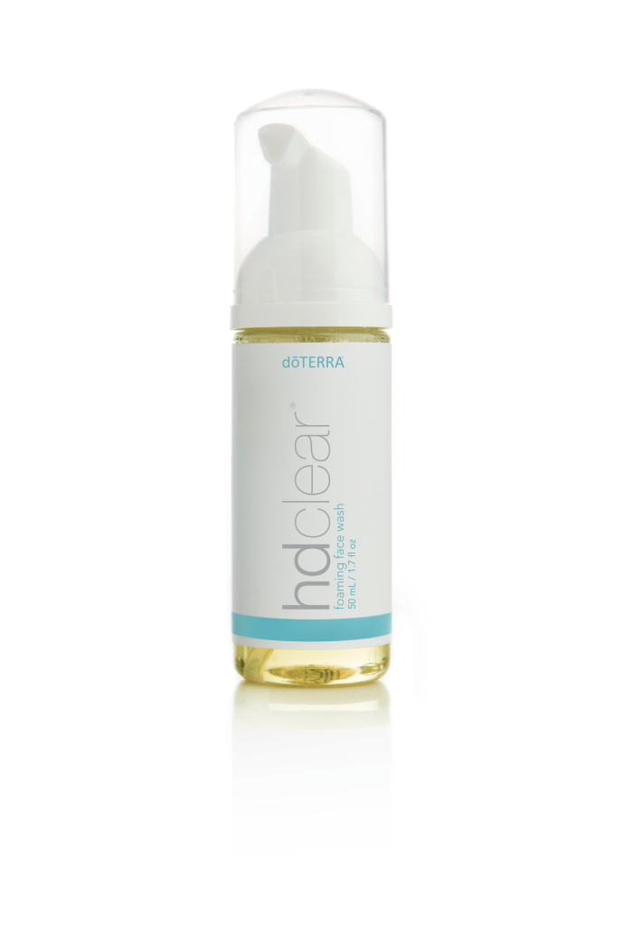
Foaming Hand Wash On-The-Go

Slide 20
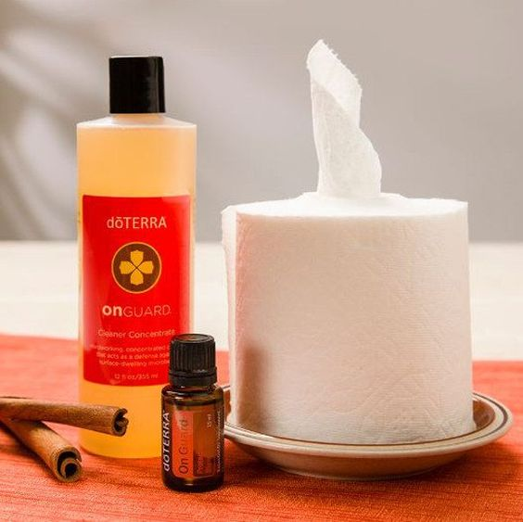

Slide 21
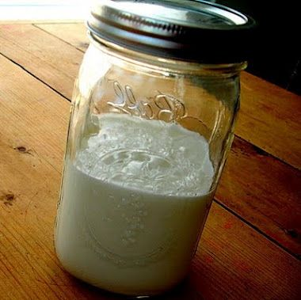
DIY Soft Scrub
Creamy Soft Scrub:
¾ cup baking soda
¼ cup liquid castile soap
1 Tbs. water
1 Tbs. vinegar
5 drops Lemon & 5 drops Lime

Slide 22
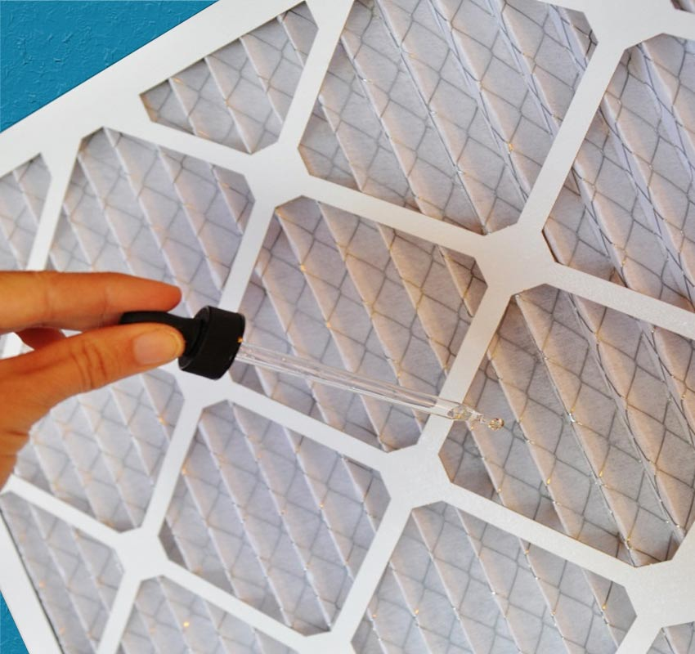
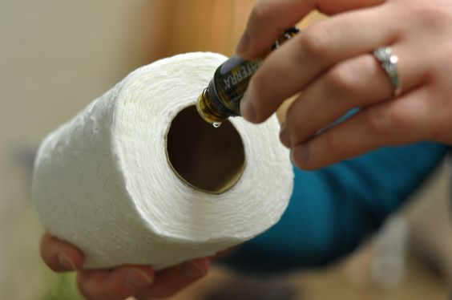
Creative Ways to Clean the Air in Your Home

Slide 23
Absorb dangerous toxins in the air (up to 87%)
Boost oxygen levels
Look great and don’t cost much
Certified Pure Therapeutic Grade
© 2012 dōTERRA Holdings, LLC, Unauthorized duplication prohibited

Slide 24
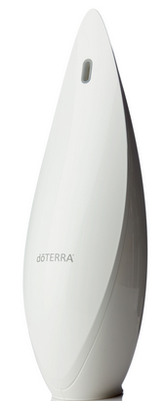
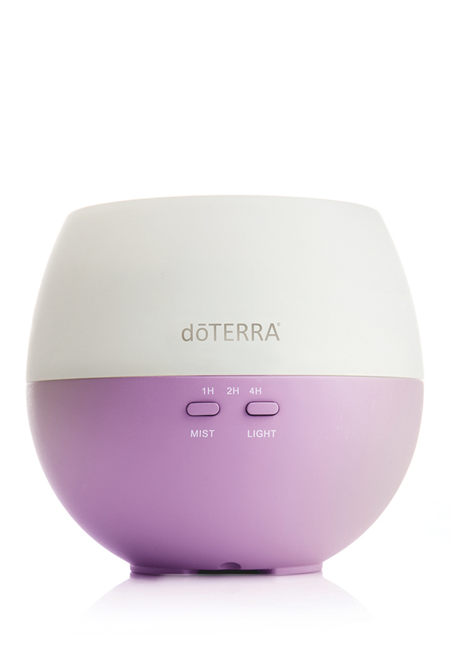
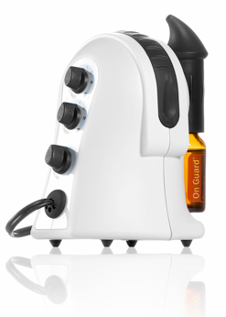
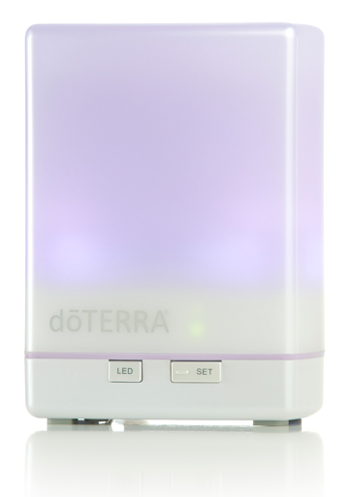
DIFFUSE dōTERRA Oils daily!
Notes:
When diffused in our homes, they increase the amount of oxygen in the atmosphere.
Oils (i.e. Frankincense & Breathe) transport oxygen and nutrients into our cells and brain.
They destroy pet odors, attack mildew, and absorb airborne dust particles.
Essential oils are by far the healthiest, cleanest way to deodorize our homes.

Slide 25
What Our Family LOVES about Green Cleaning:
Cleaning is FUN
You could even EAT the cleaners
No more SAFETY latches
Saving MONEY
Teaching STEWARDSHIP
Leading by EXAMPLE

Slide 26
Notes:
“Once you green one aspect of your life, I can guarantee that you’ll want to continue. Going green is a constantly evolving process that all follows from that first tiny step.”
The Key here is to start small. Small changes add up to great change. Green living is a process. You can’t do everything all at once. Just pick a few things that really jumped out to you and focus on that and let it grow from there.

